Slide 1
BM Project – Human Data Update 3
Parameter sweep clustering | BC_ER+ separation | Highlight + ESR1/SP1 analysis
Jianting Sheng | Houston Methodist Neal Cancer Center

Slide 2
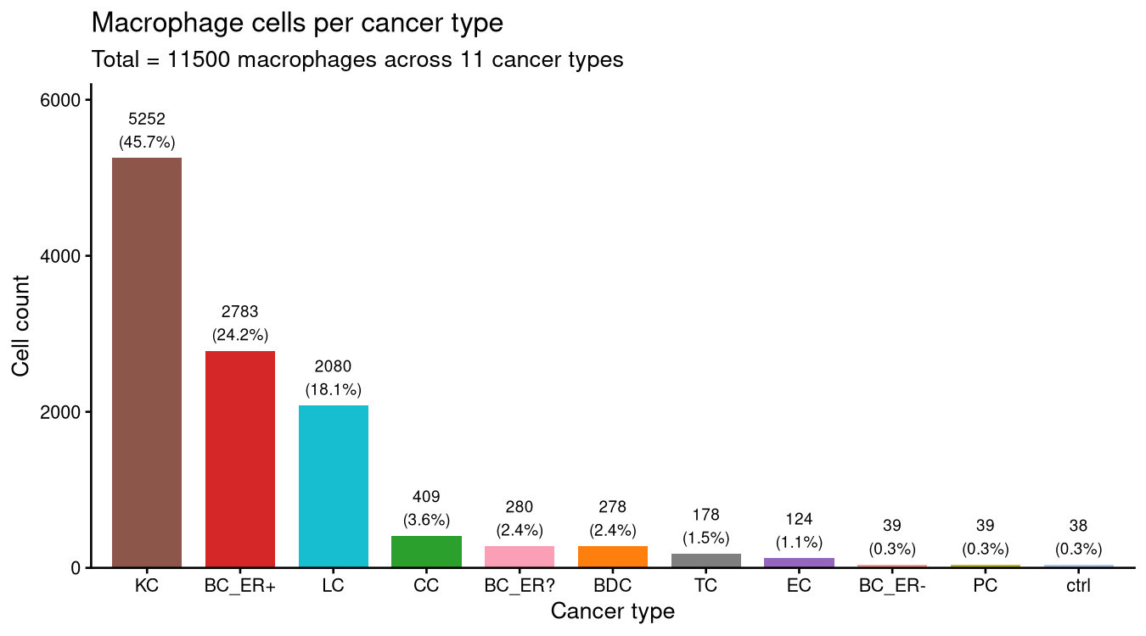
Sanity Check — Macrophage Cells per Cancer Type

Slide 3
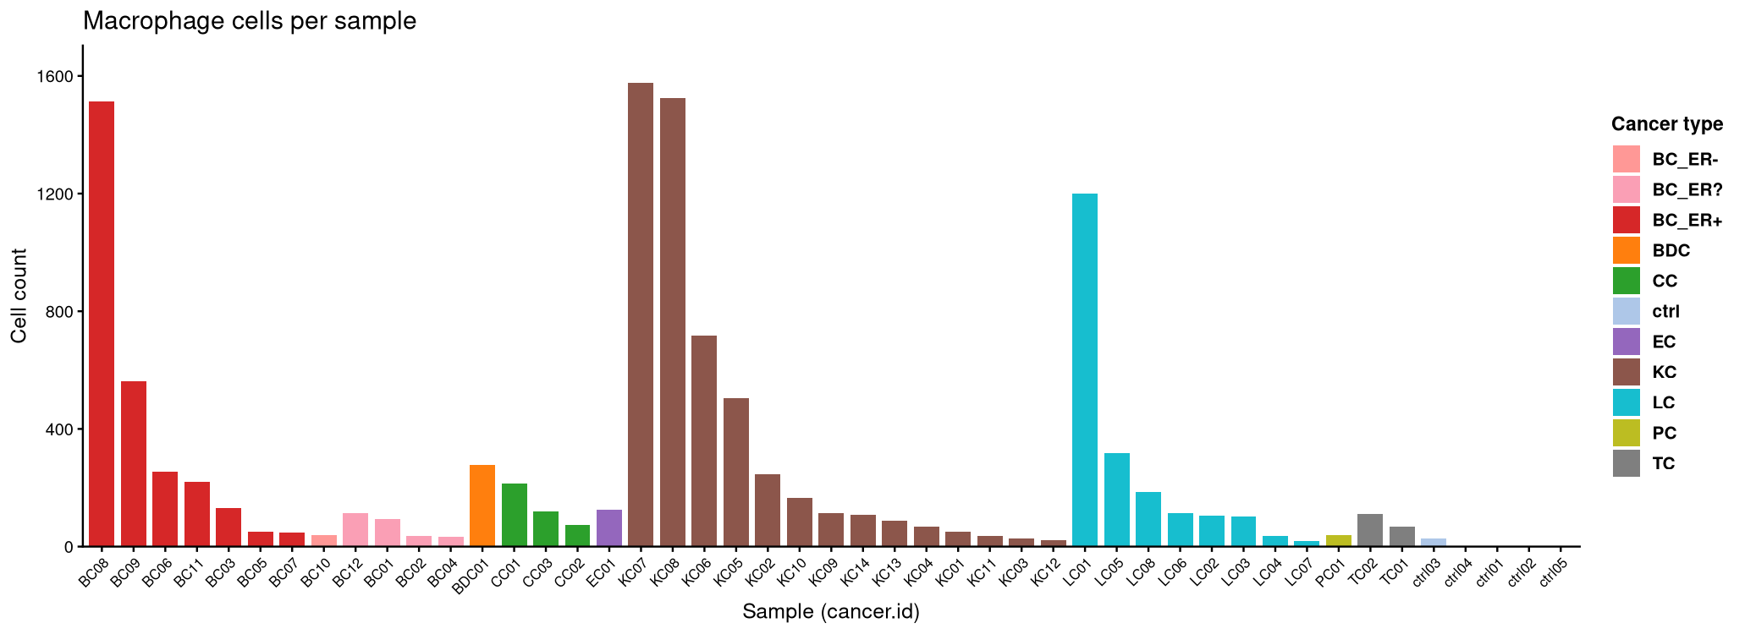
Sanity Check — Macrophage Cells per Sample

Slide 4
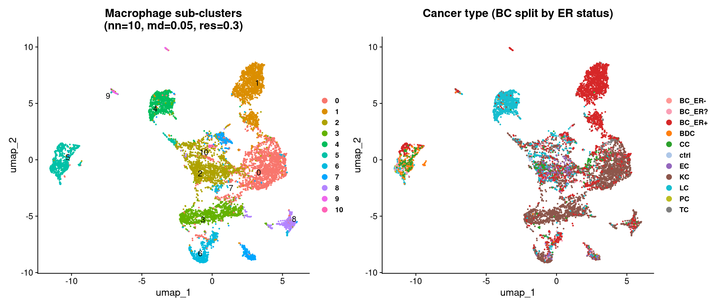
Macrophage Sub-clustering UMAP — Best Params
n.neighbors=10 min.dist=0.05 resolution=0.3 n_clusters=11

Slide 5
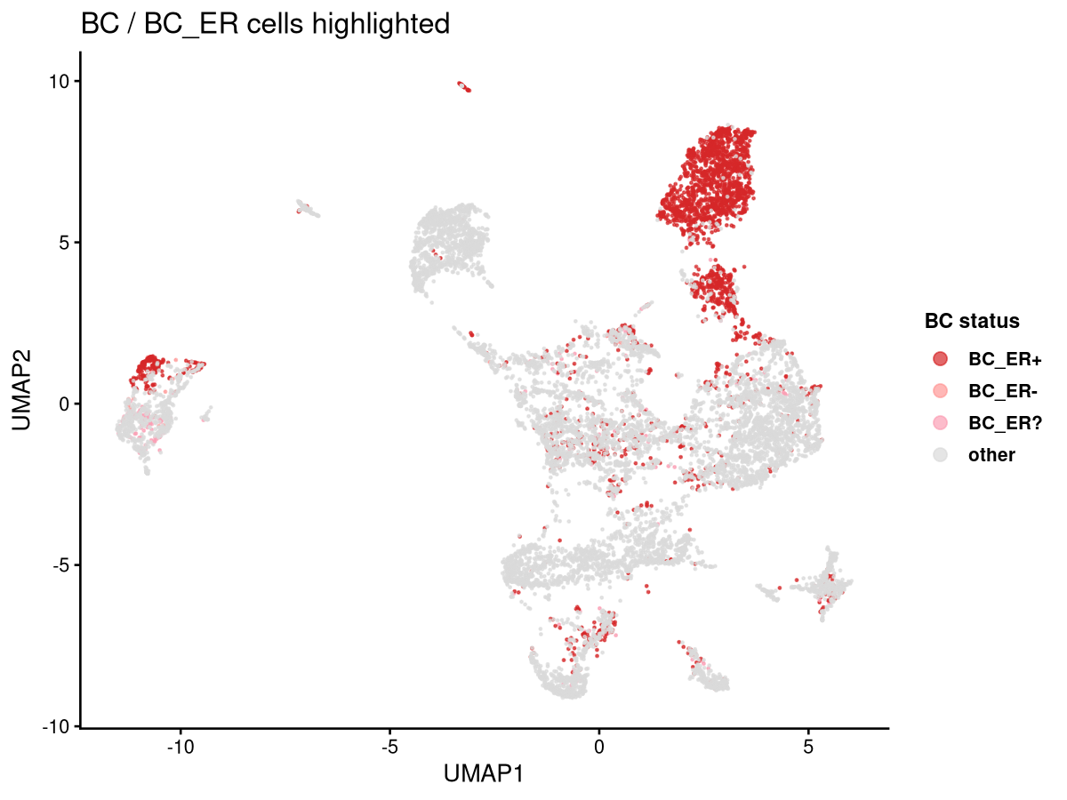
BC / BC_ER Cells Highlighted on UMAP

Slide 6
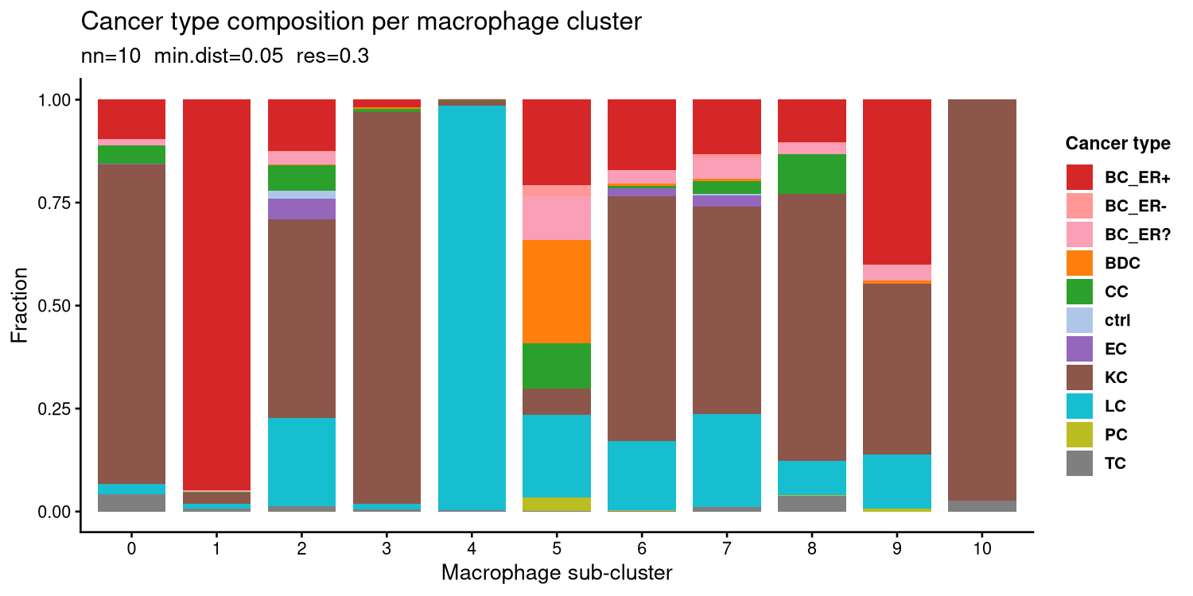
Cancer Type Composition per Macrophage Cluster

Slide 7
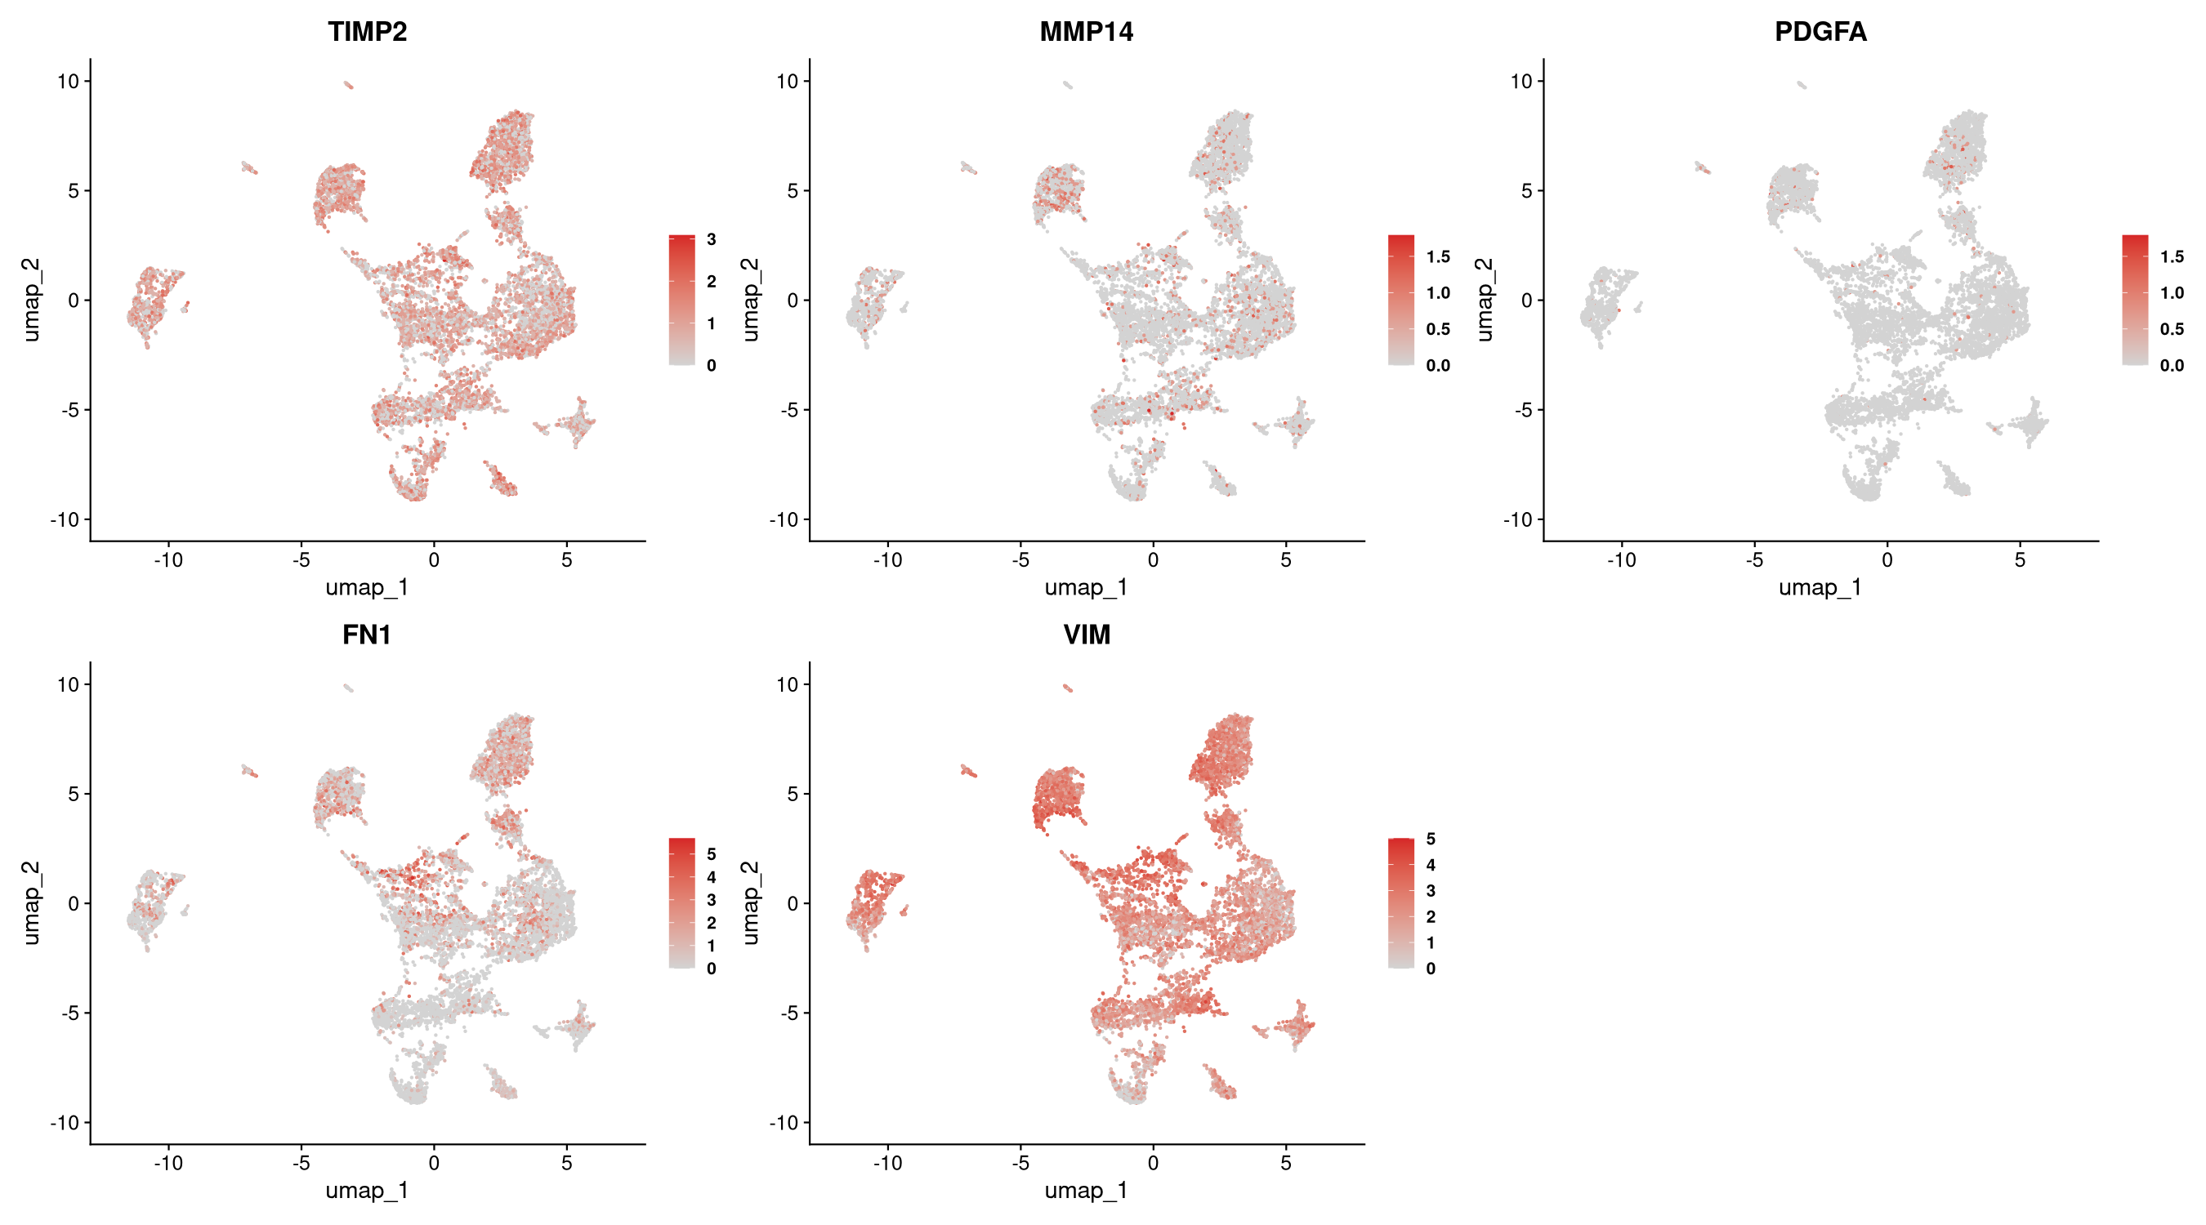
Feature Plots — Highlight Genes

Slide 8
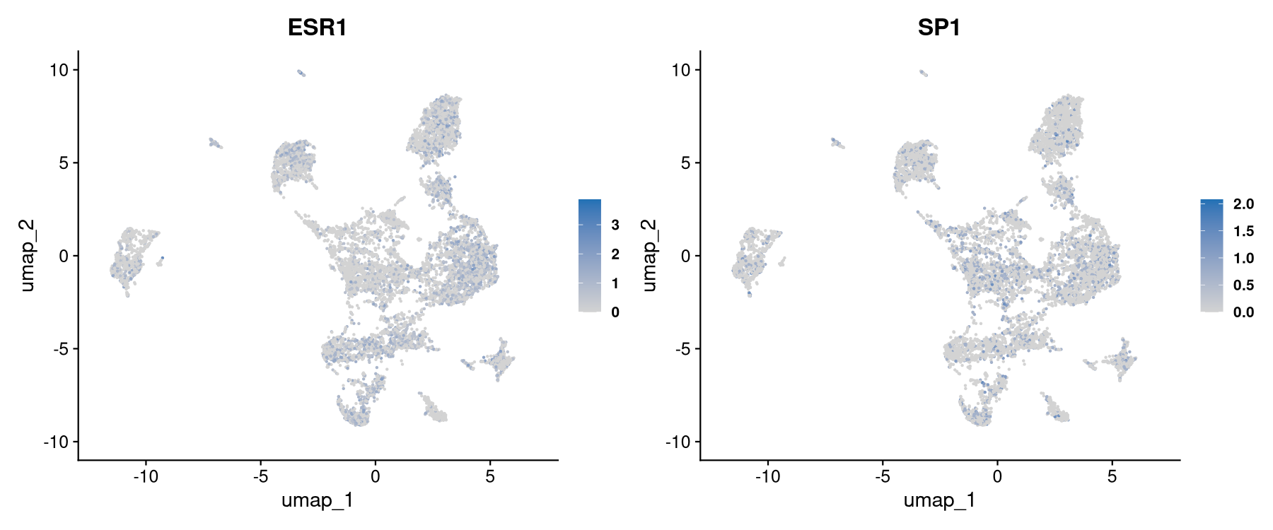
Feature Plots — ESR1 / SP1

Slide 9
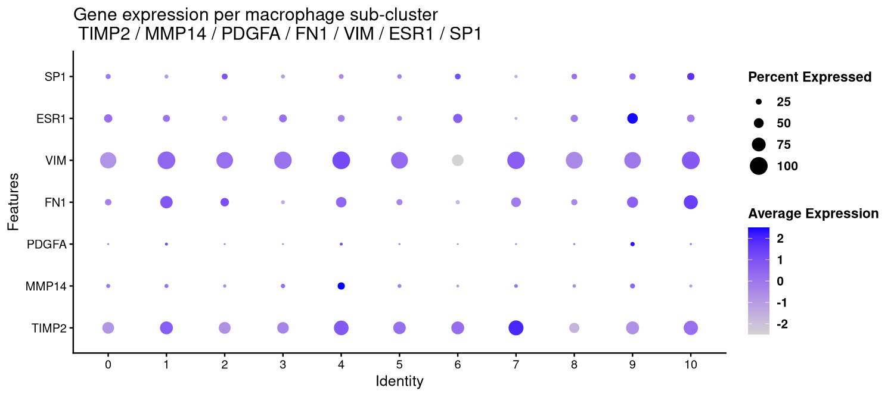
Combined Dot Plot — Highlight + ESR1/SP1

Slide 10
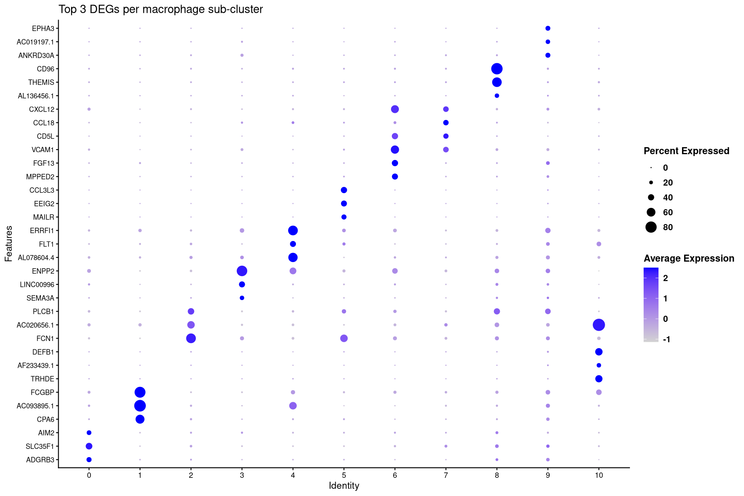
DEG Dot Plot — Top 3 Marker Genes per Cluster

Slide 11
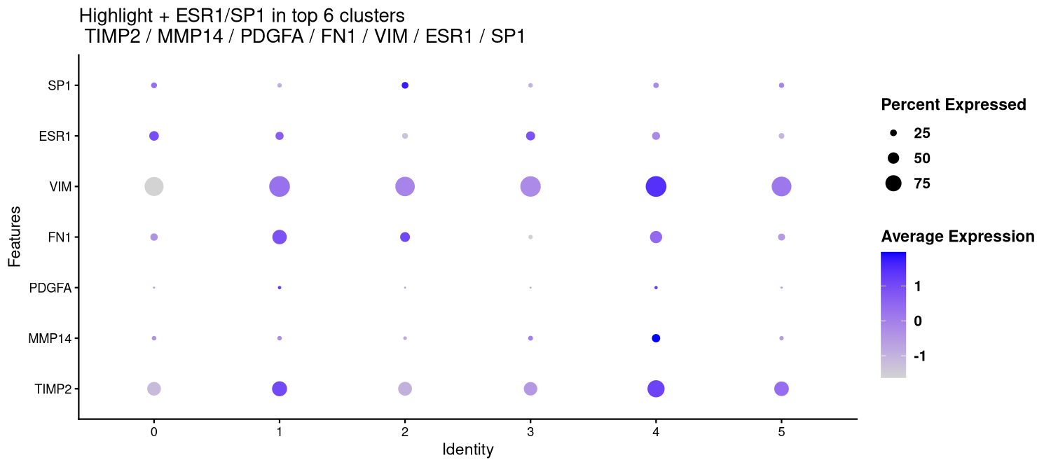
Highlight + ESR1/SP1 Expression — Top 6 Clusters

Slide 12
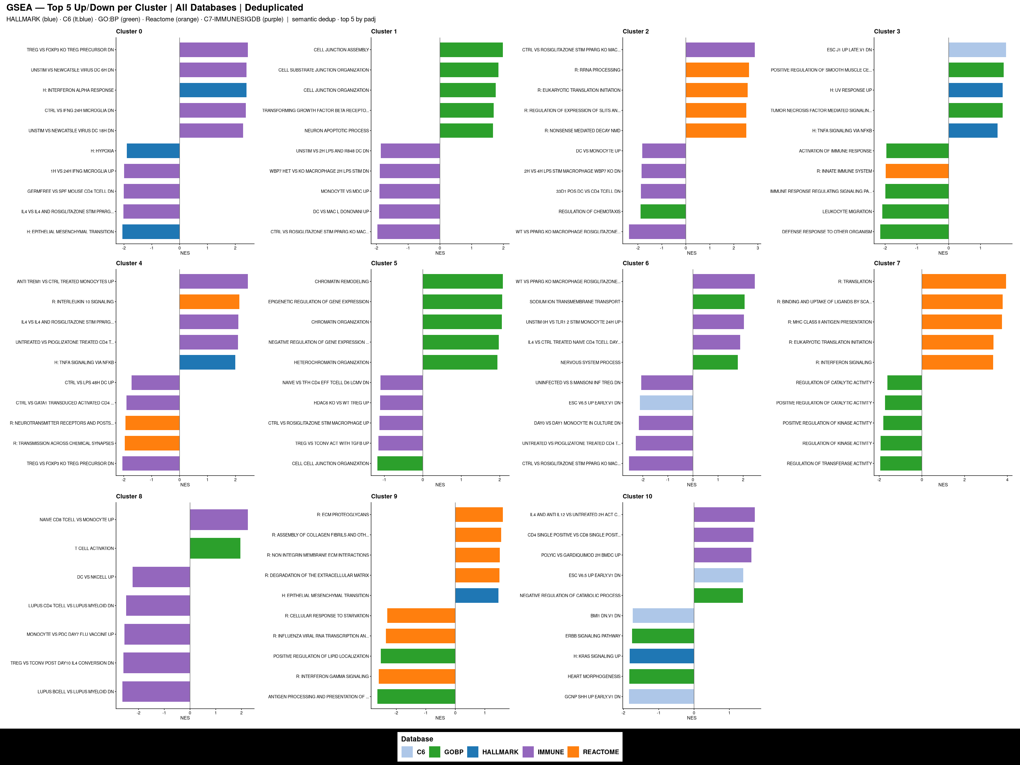
GSEA — All Databases | Top 5 Up/Down per Cluster
HALLMARK (blue) · C6 (lt.blue) · GO:BP (green) · Reactome (orange) · C7-IMMUNESIGDB (purple)

Slide 13
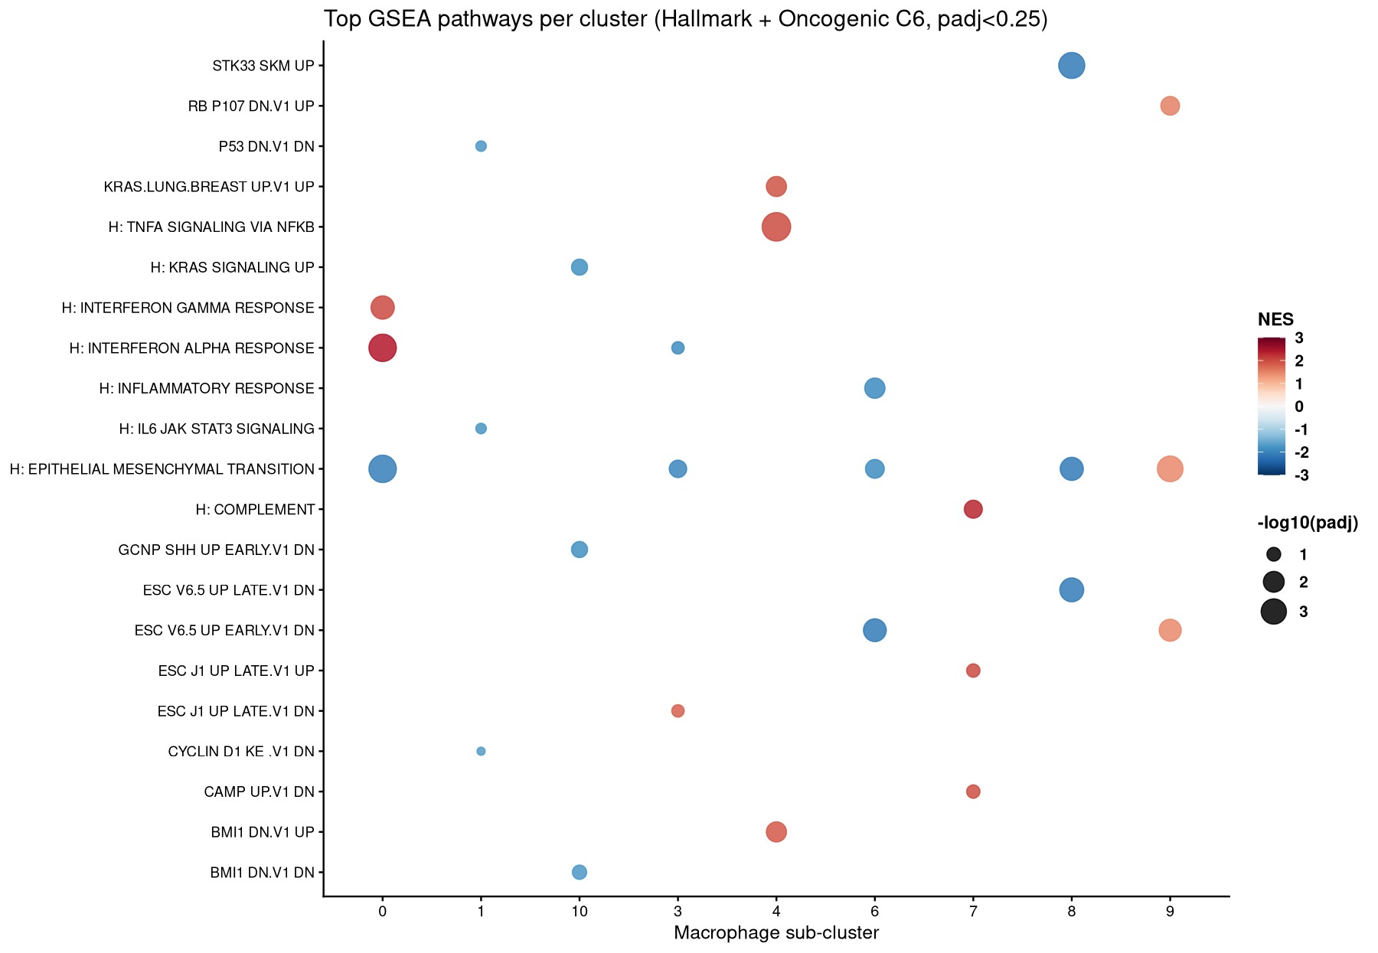
GSEA — Top Pathways per Cluster (Bubble Plot)

Slide 14
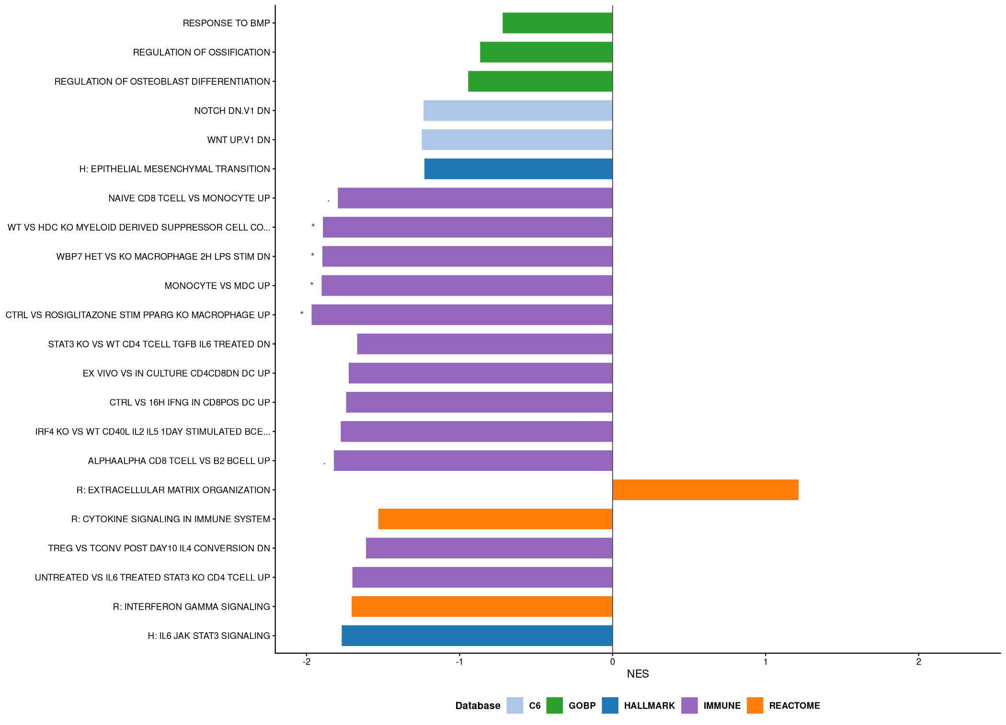
GSEA (Broader) — Cluster 1 (BC_ER+) by Hypothesis

Slide 15
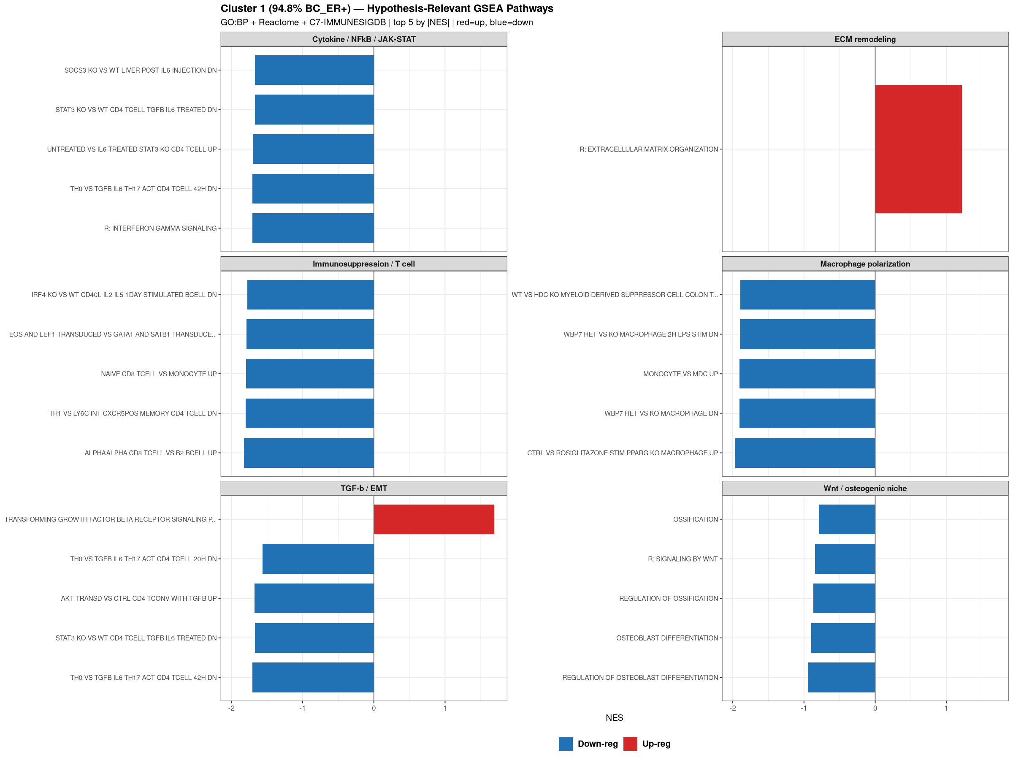
GSEA — Cluster 1 Hypothesis Groups (Colored by Direction)

Slide 16
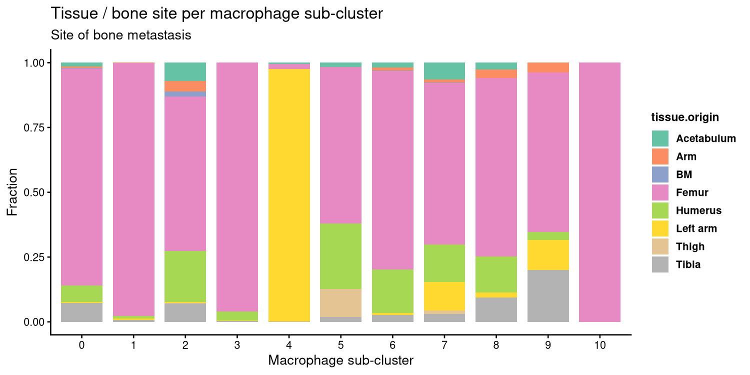
Bone Site / Tissue Origin per Macrophage Sub-cluster

Slide 17
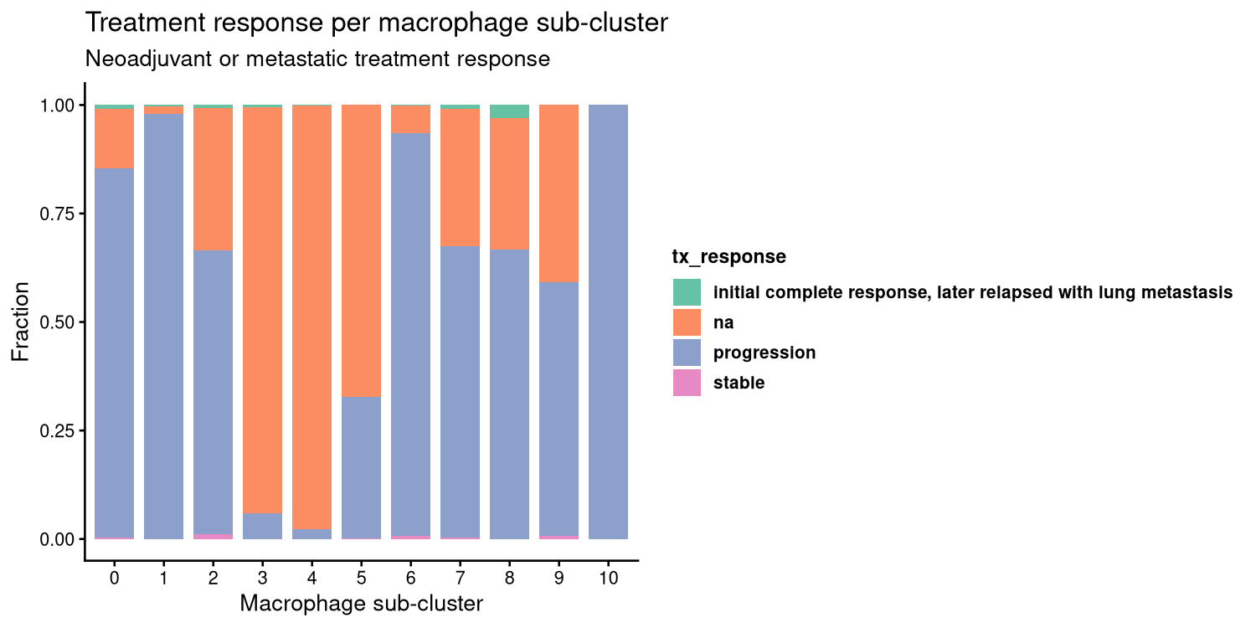
Treatment Response per Macrophage Sub-cluster

Slide 18
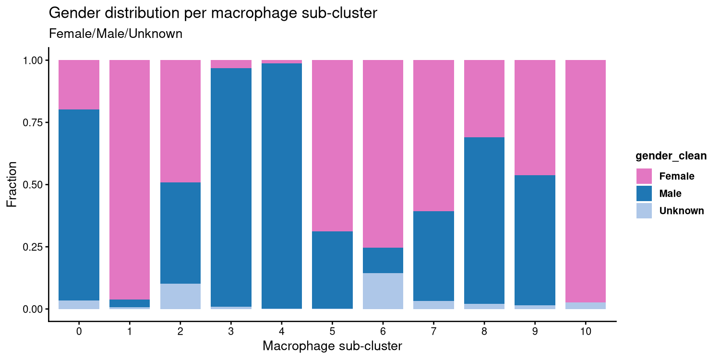
Gender Distribution per Macrophage Sub-cluster

Slide 19
Summary — Update 3
Clustering
• Cluster 1: 1791/1889 cells = 94.8% BC_ER+
– res=0.3 dominant; UMAP params irrelevant
– BC08 = 54% of all BC_ER+ cells (single-patient dominance)
Gene expression
• Cluster 10 highest for TIMP2/MMP14/PDGFA/FN1/VIM
– Cluster 1 (BC_ER+) ranks 3rd
• ESR1/SP1 co-expression not exclusive to Cluster 1
Hallmark / Oncogenic GSEA (H + C6)
• Cluster 1: no significant terms (all padj>0.15)
– Trending down: IL-6/JAK/STAT3, IFN-g, KRAS-breast
• Cluster 0: IFN-a/g strongly UP (padj<0.003)
• Cluster 4 (LC): KRAS + mTORC1 + TNFa/NFkB UP
• Cluster 8: STK33 DN, Allograft rejection UP
• Cluster 9: EMT UP (only cluster)
Broader GSEA (GO:BP + Reactome + C7-IMMUNESIGDB)
• Cluster 1 (BC_ER+) — 21 deduplicated terms:
– Mac. polarization: PPARG-KO, WBP7-KO, MDSC DOWN
(all padj<0.05 — strongest signals in cluster 1)
– Cytokine: IFN-g signaling, cytokine network DOWN
– TGF-b: TH17/TGF-b/IL-6, AKT-TGF-b DOWN
– Immunosuppression: T cell activation DOWN
– Wnt/osteogenic: Wnt signaling (Reactome) DOWN
– ECM: ECM organization weakly UP
Interpretation re: BM manuscript
• BC_ER+ macrophages appear transcriptionally suppressed
– Consistent with immunosuppressive ER+ TME
– Down-regulated Wnt may reflect niche dependency
– PPARG/WBP7/MDSC signatures: non-classical activation
Next steps
• DEG: Cluster 1 vs BC_ER- clusters
• Validate SP1/ESR1 co-expression in Cluster 1
• Link to S2C2 crosstalk; validate in mouse W2/W3
★ Cluster 1: 1791/1889 cells = 94.8% BC_ER+ | BC_ER+ macrophages: immunosuppressed, non-classical, Wnt/cytokine DOWN

